Slide 1
CUNY Data Analytics Final Project
Looking at CRIME Data in NYC from 2006 to 2022

Slide 2
What are the Questions?
On what day of the week do most crimes take place?
What month do most crimes take place?
Where do select crimes take place?

Slide 3
What is the Data?
This is the arrest record of the type and location of crimes committed in NYC from
2021-01-01 to 2021-09-30. This data includes some demographic information as well as borough location of the arrest.
The libraries used include Pandas, Numpy, Dash, and Potly and datashader.

Slide 4
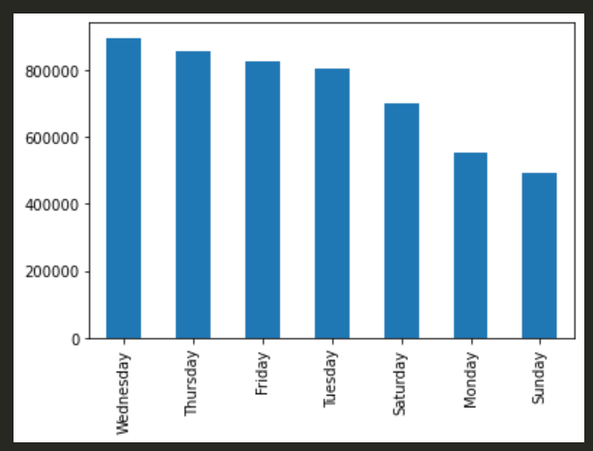
What day of the week Bring the most crime?

Slide 5
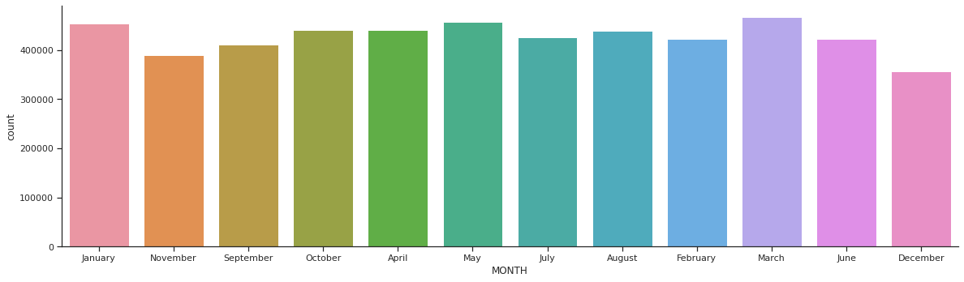
What Month has the most arrests

Slide 6
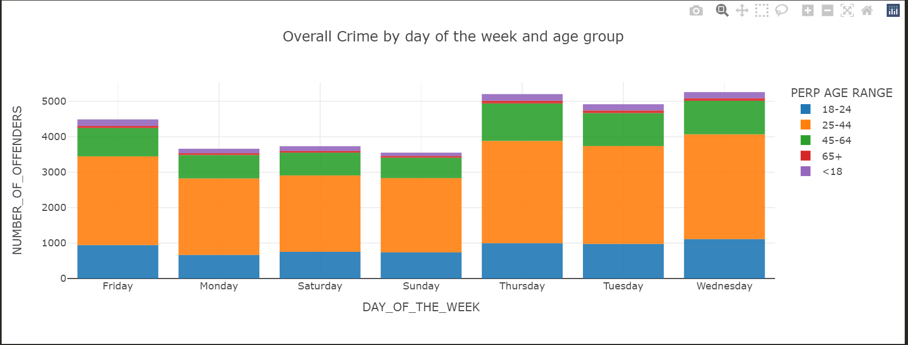
Total Crime by day of week

Slide 7
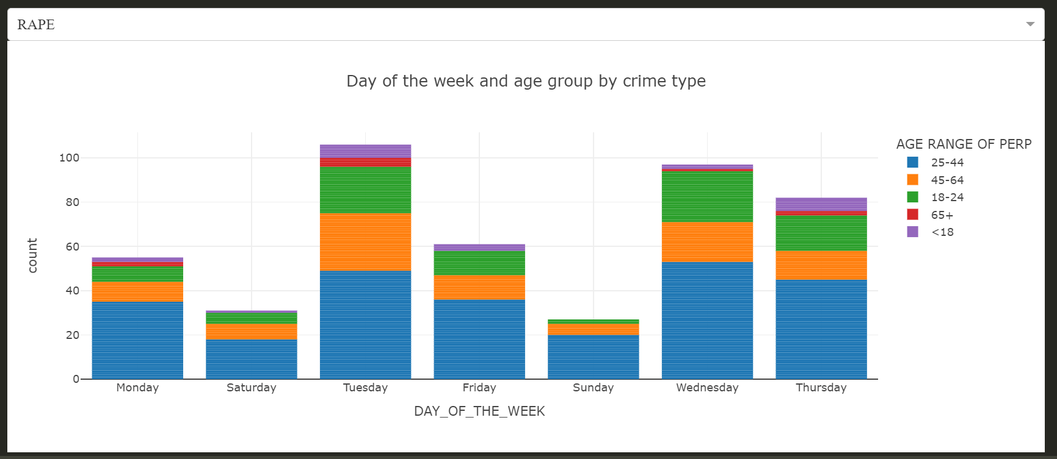
Select Crime arrests based on the day of the week

Slide 8
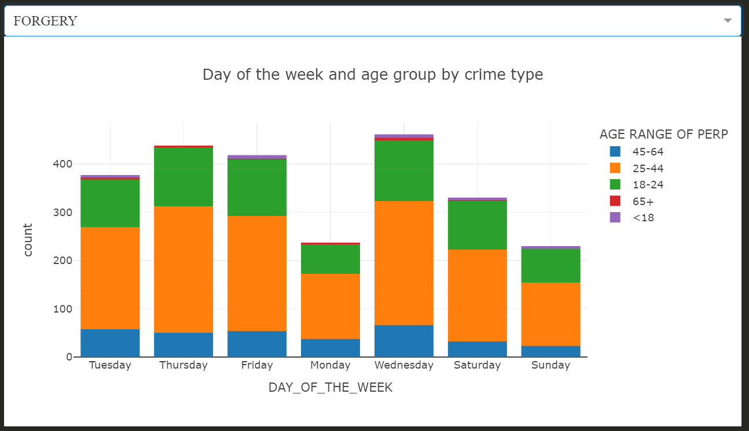
Select Crime arrests based on the day of the week

Slide 9
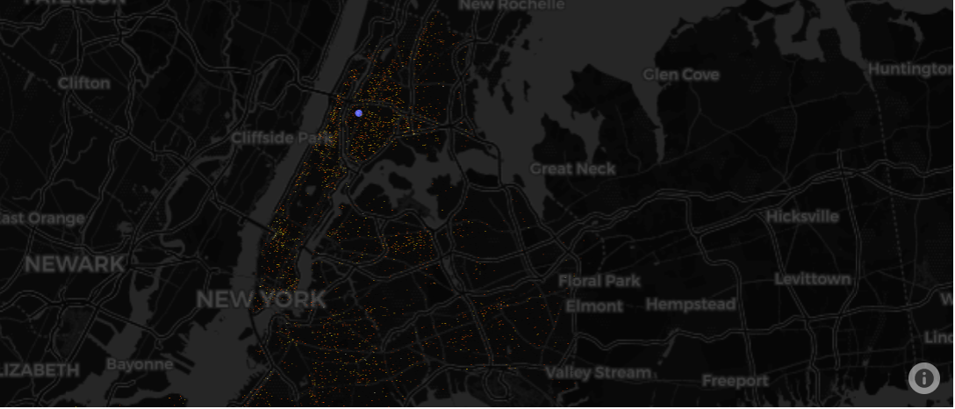
A data-shader map that shows the concentration of ‘ASSAULT 3 & RELATED OFFENSES’ in the Bronx relative to NYC.

Slide 10
What can be done
Based on the data from 2006 to 2020 NYC can do several things to combat these crimes
The NYPD can have police patrol on days when crime is highest more frequently. Also by shifting staffing to days when it is predicted to have high levels of crime, the NYPD can also save money by allocating staff appropriately. Also by looking at the location of ‘high value’ crimes, one can better predict where these crimes will take place.

